Slide 1
Public Redistricting Maps

Slide 2
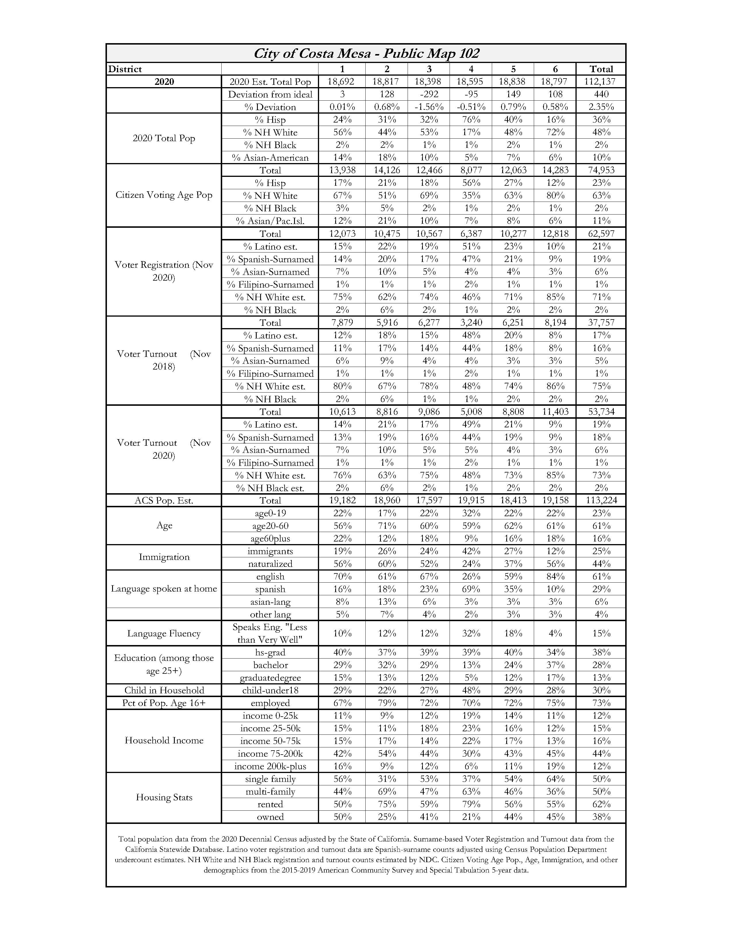

Slide 3
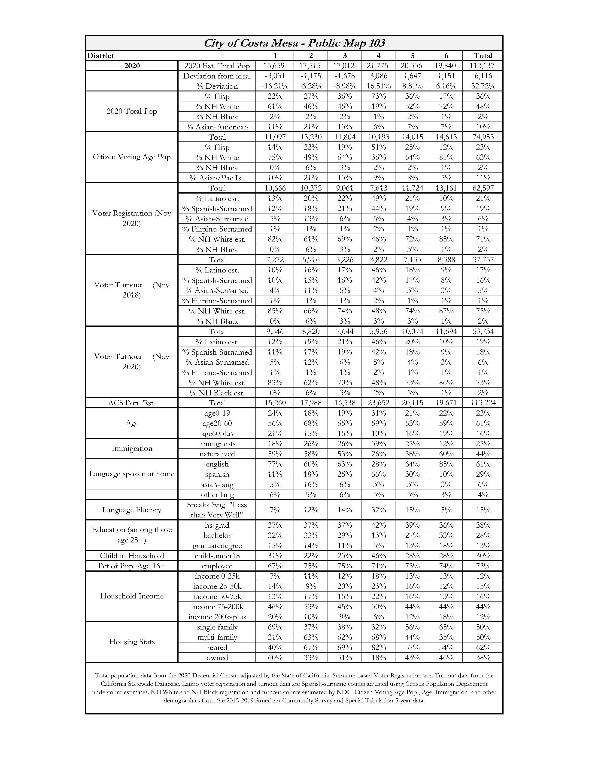

Slide 4
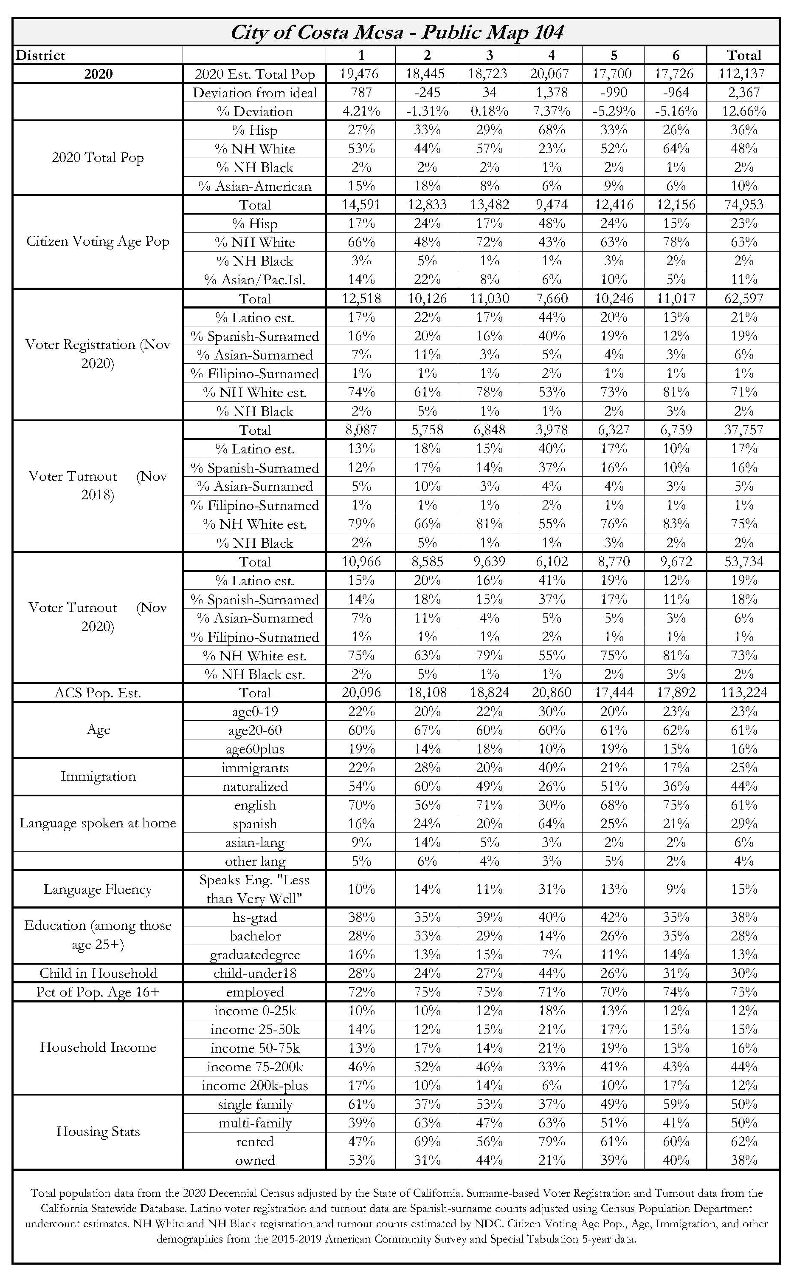

Slide 5
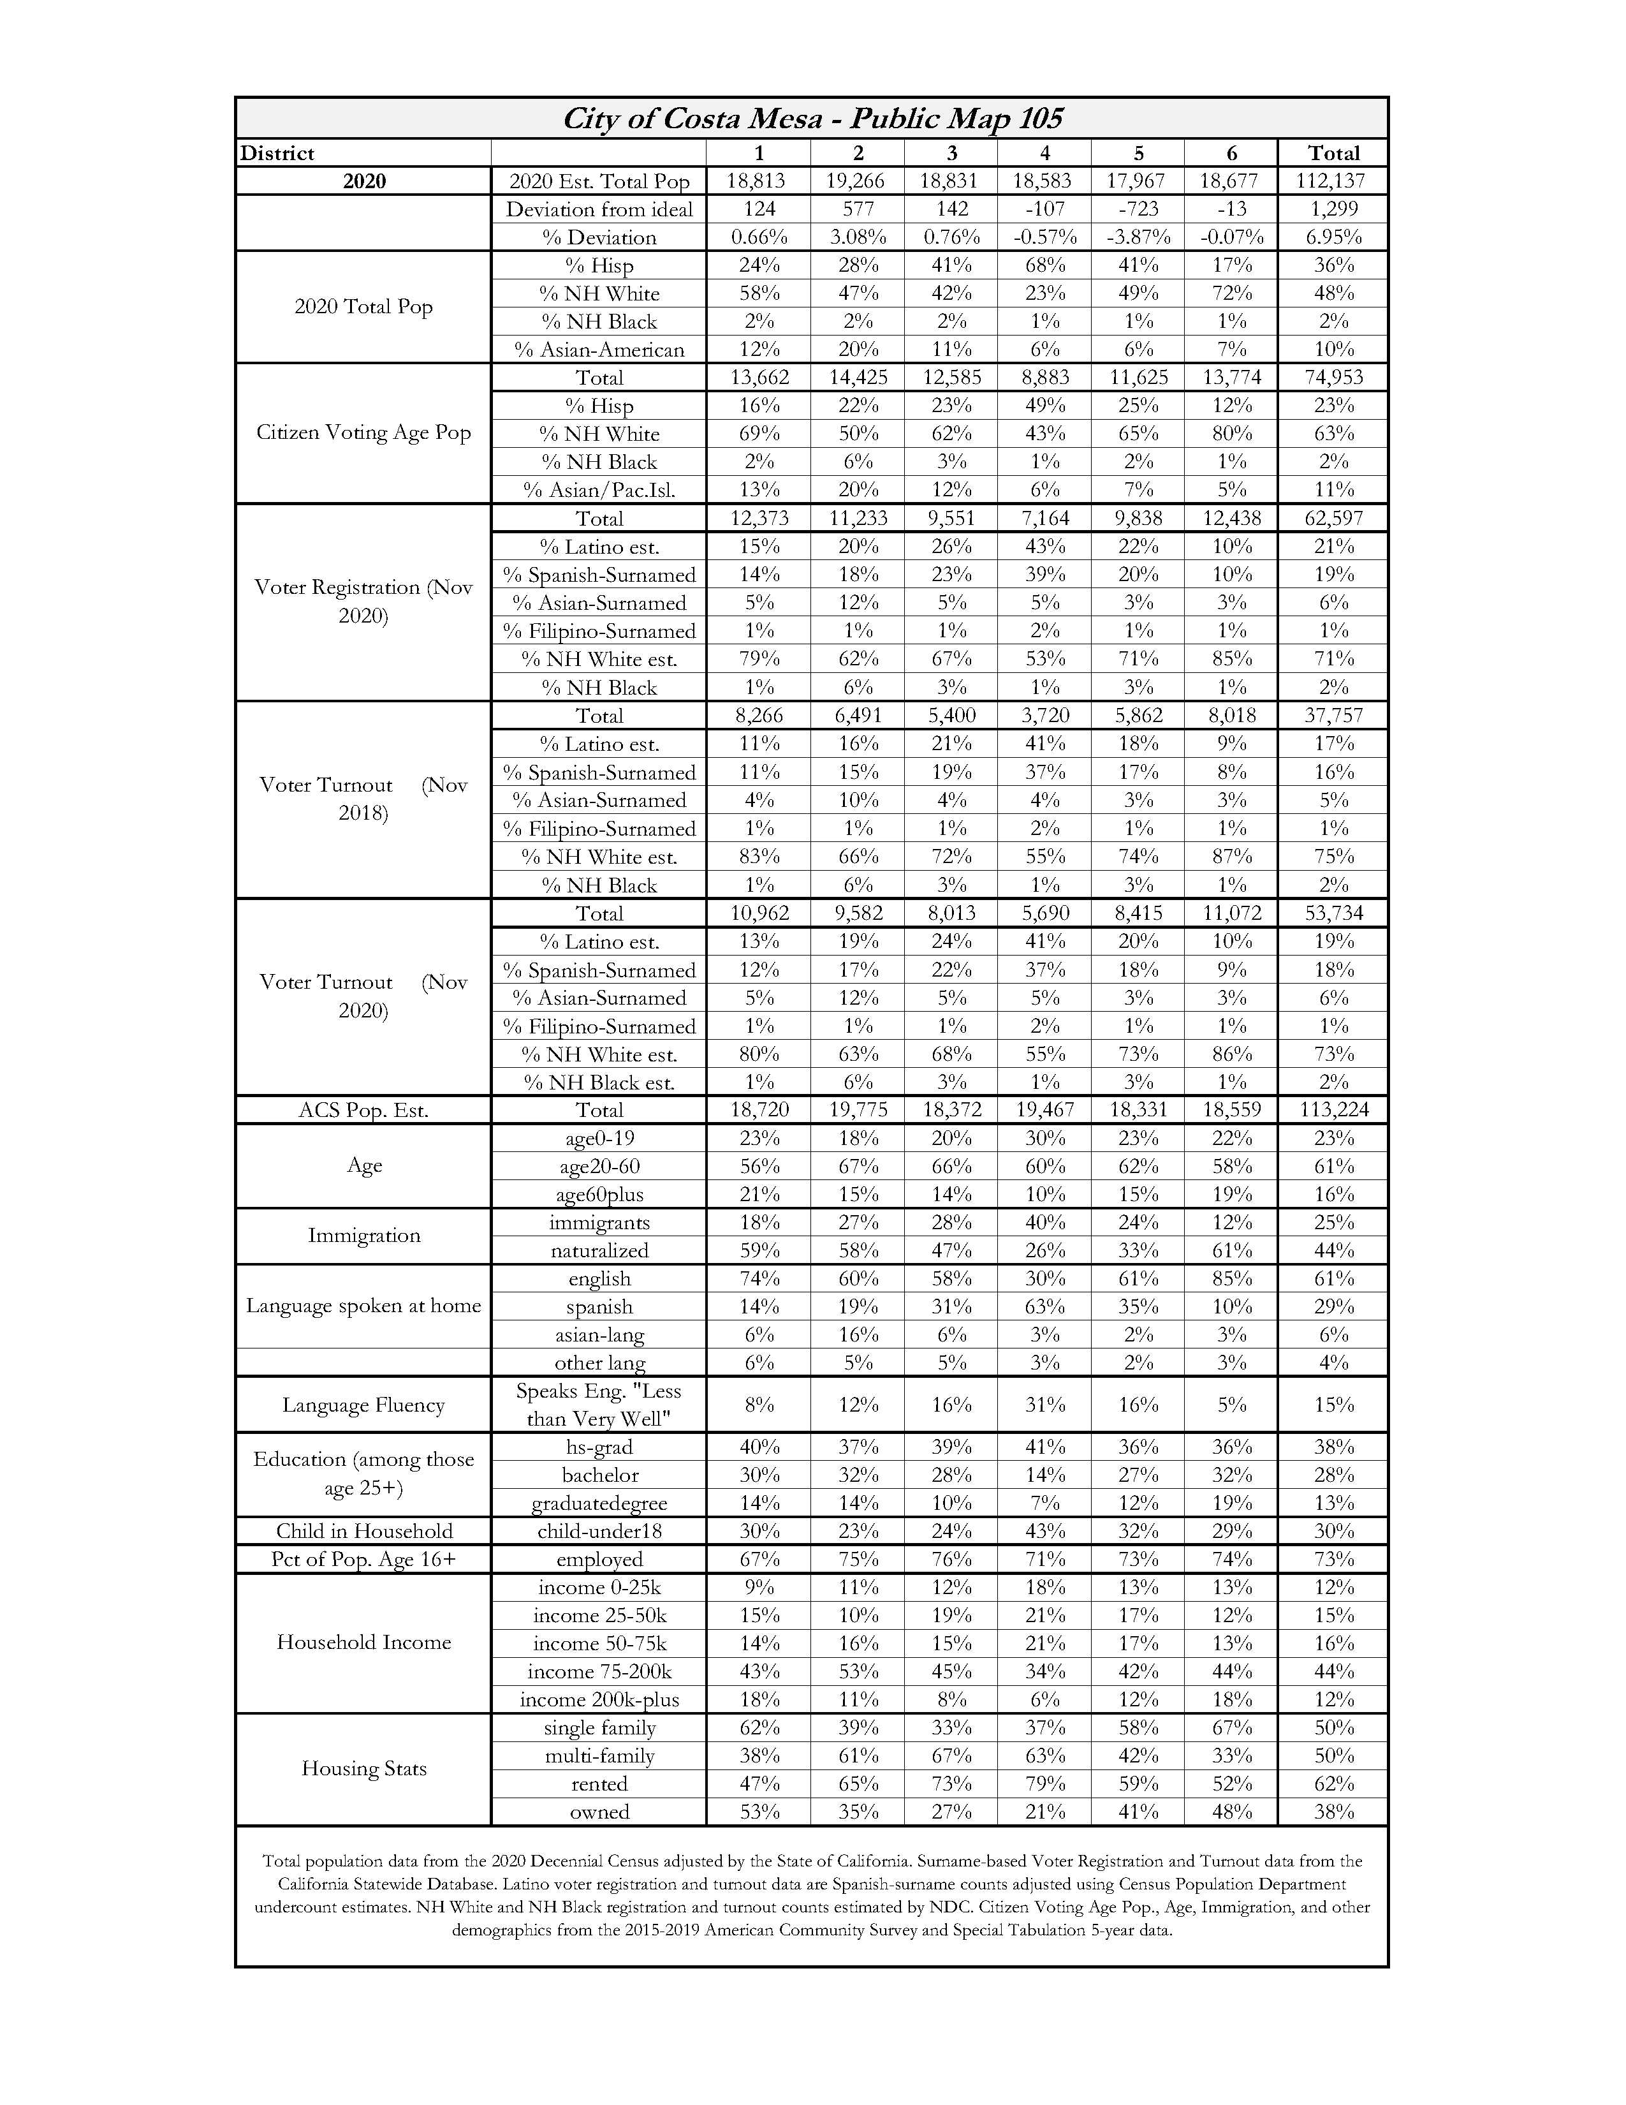

Slide 12
Maps provided by ndc

Slide 16
