Slide 1
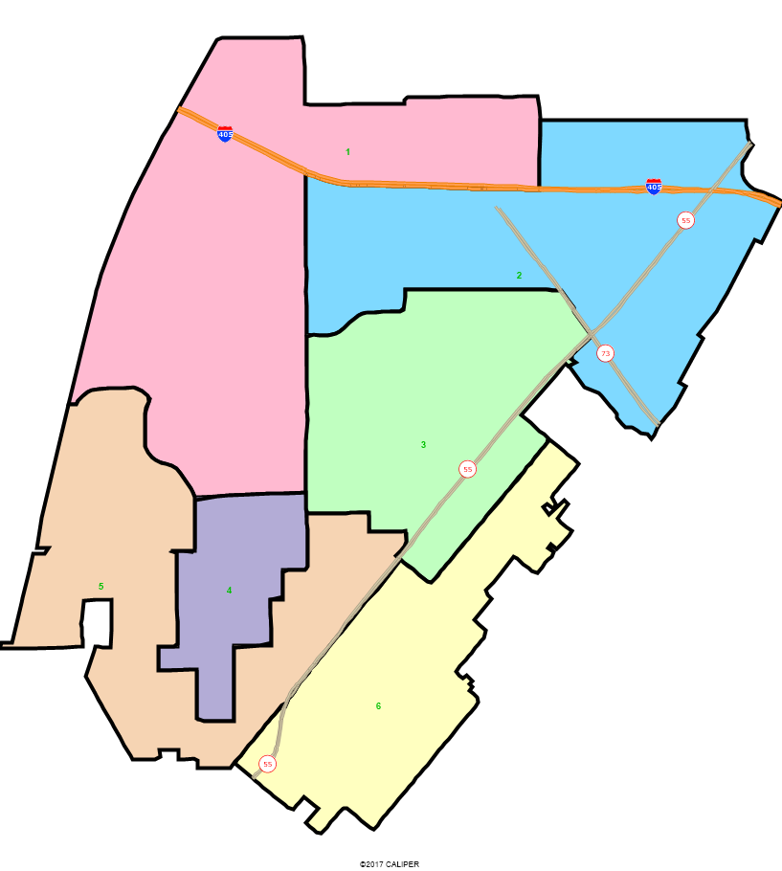
City of Costa Mesa
Draft Plan Presentation
Dr. Justin Levitt, Vice President
National Demographics Corporation

Slide 2
Redistricting – Why Now?
Costa Mesa moved to districts in 2017 after voters approved Measure EE in November 2016
Costa Mesa election used districts for first time in 2018 and again in 2020
Redistricting is required when the decennial Census data is released, once every ten years
Delays in receiving the Census data have delayed states, counties, cities, and other jurisdictions throughout California and the US
New laws like the Fair Maps Act have changed how districts are drawn and how the process is conducted

Slide 3
Redistricting Process
Step | Description
Informational Session August 3, 2021 | Explain the redistricting process Educate and solicit input on communities of interest
Census Data Release August 16, 2021 | Census Bureau releases official 2020 Census population data; official state prisoner-adjusted counts released on Sept 20, 2021
Public Hearing 1 October 19 | Educate and solicit input on communities of interest
Community Forums October 23, December 1 & January 8 | Workshops held at different locations throughout the community to provide training on the tools and take public comment on communities of interest/draft maps
Two Draft Map Hearings November 16 & February 15 | Two Public Hearings to discuss and revise the draft maps and to discuss the election sequence.
Map Adoption March 2022 | Final map must be posted at least 7 days prior to adoption. State deadline for adoption is April 17, 2022
November 2022 | First Election with new districts

Slide 4

Redistricting Rules and Goals
1. Federal Laws
2. California Criteria for
Cities
3. Other Traditional Redistricting Principles
Equal Population
Federal Voting Rights Act
No Racial Gerrymandering
Geographically contiguous
Undivided neighborhoods and “communities of interest”
(Socio-economic geographic areas that should be kept together)
Easily identifiable boundaries
Compact
(Do not bypass one group of people to get to a more distant group of people)
Prohibited: “Shall not favor or discriminate against a political party.”
Minimize voters shifted to different election years
Respect voters’ choices / continuity in office
Future population growth
Preserving the core of existing districts

Slide 5
Current District Map Overview
Total Deviation:
11.52%

Slide 6
Draft Maps as of 11/16
maps are also available on the Interactive Web Viewer

Slide 7
Draft Maps Overview
We received 7 draft map submissions prior to the deadline for submission for this hearing
  Three maps have a population deviation higher than 10%
  One map is not compact
  An additional two maps lack a majority-Latino district
NDC also added three maps to the discussion based on input from the workshops, council hearings, and submitted maps.

Slide 8
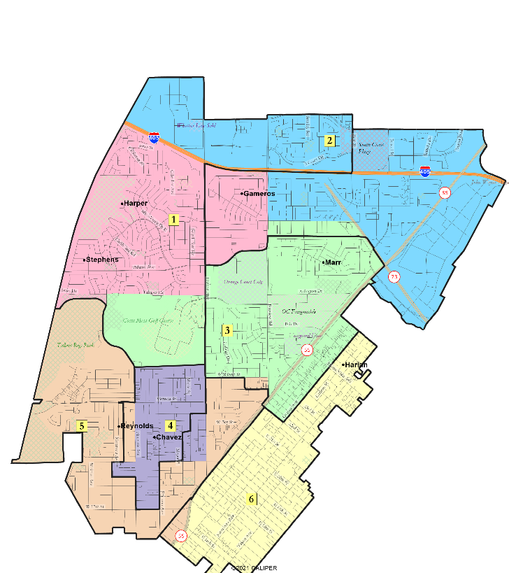
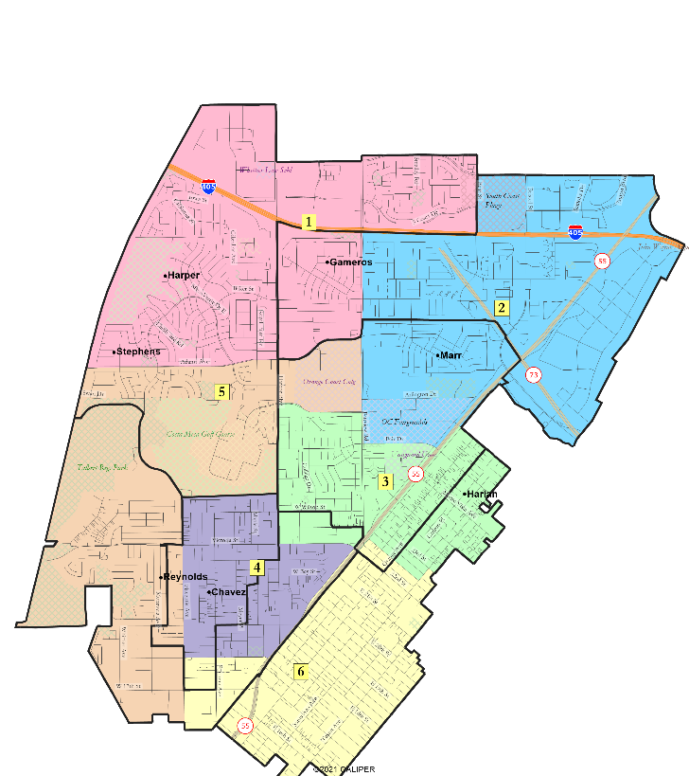
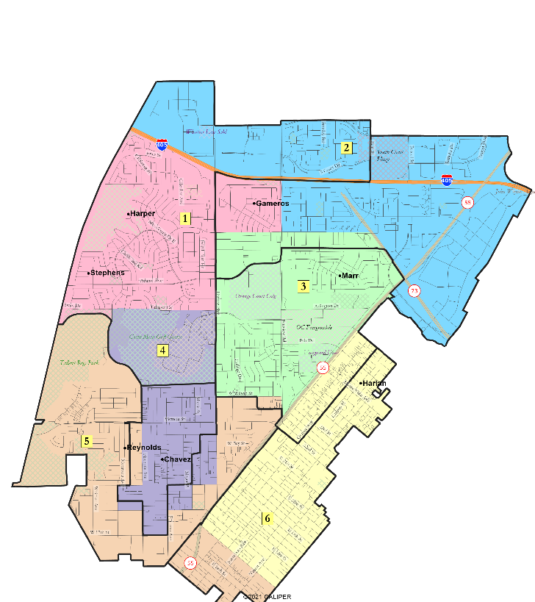
Maps not Population-Balanced
Map 103
32.7%
Map 101
10.5%
Map 104
12.7%

Slide 9
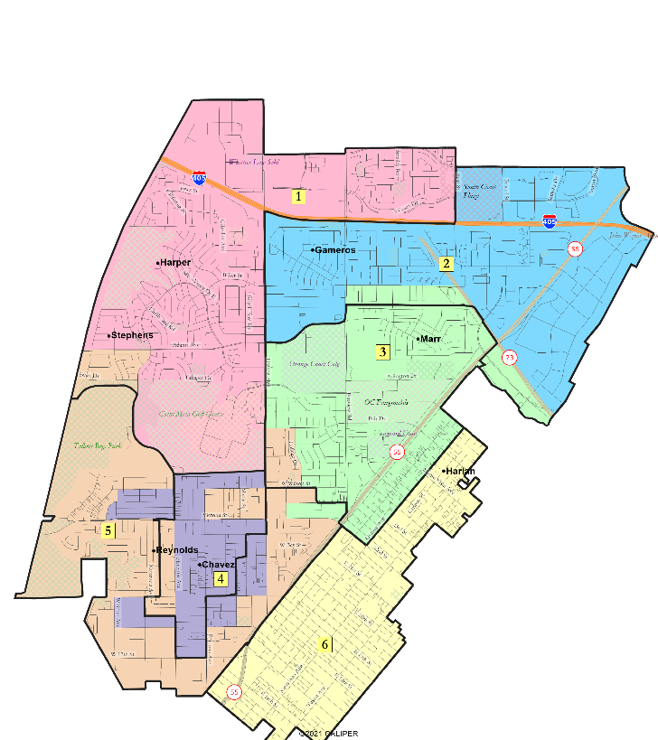
Other Maps that need modifications
Map 106
No majority-Latino district
Map 105
No majority-Latino district
Map 107
D4 is not compact

Slide 10
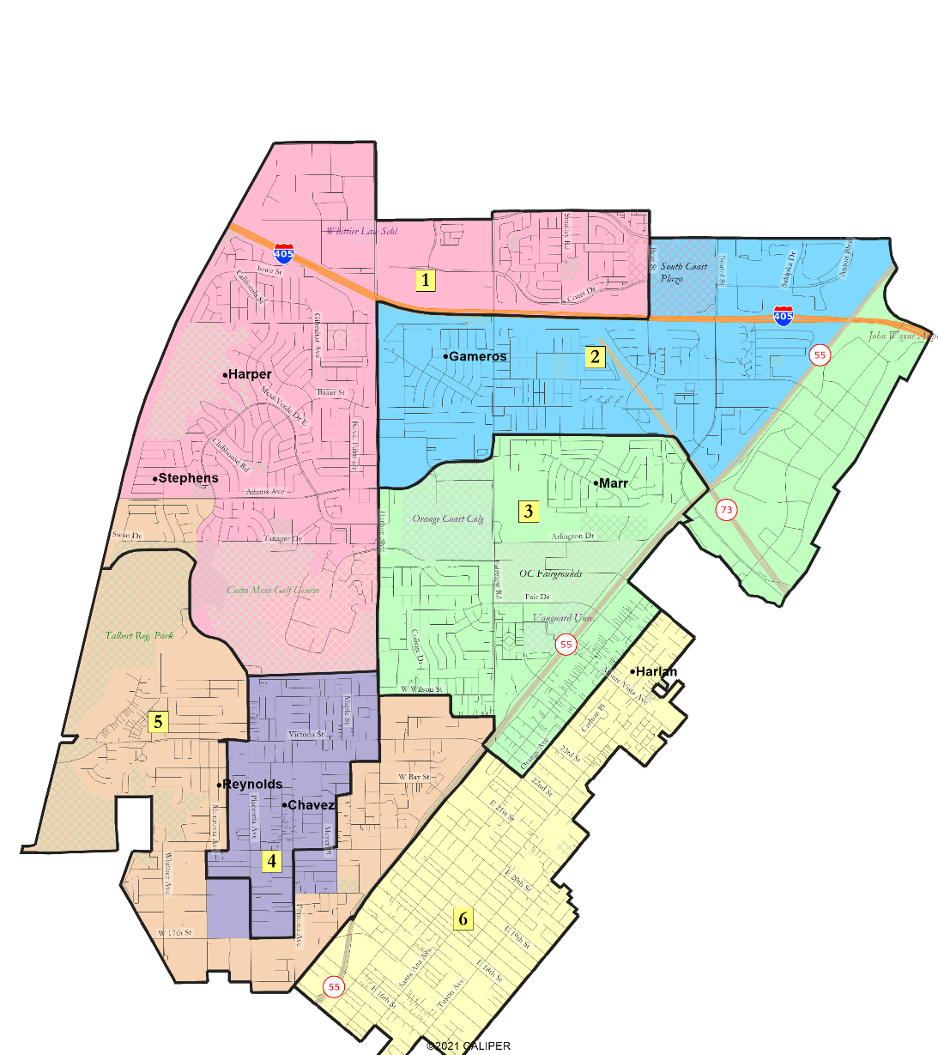
Map 102

Slide 11
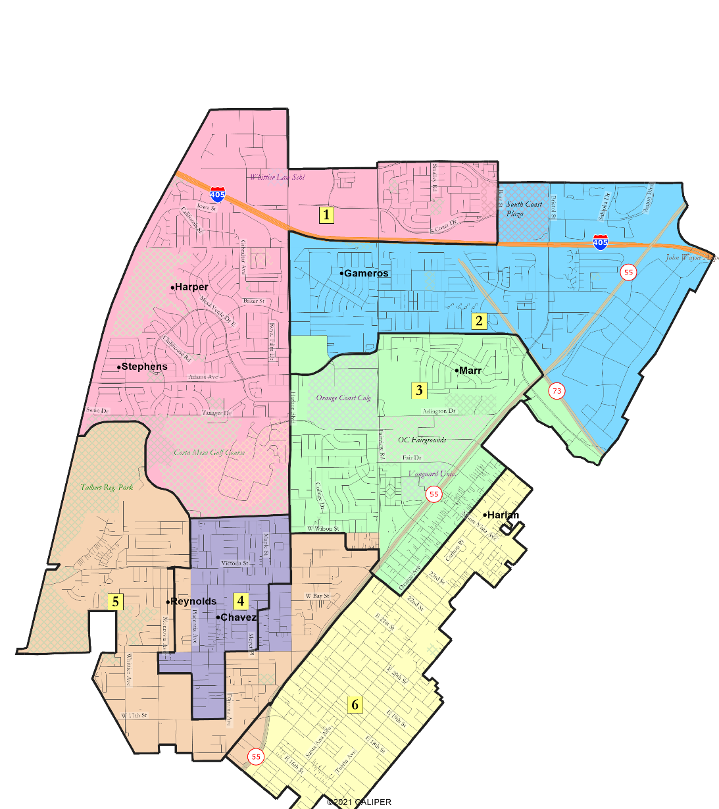
Map 108

Slide 12
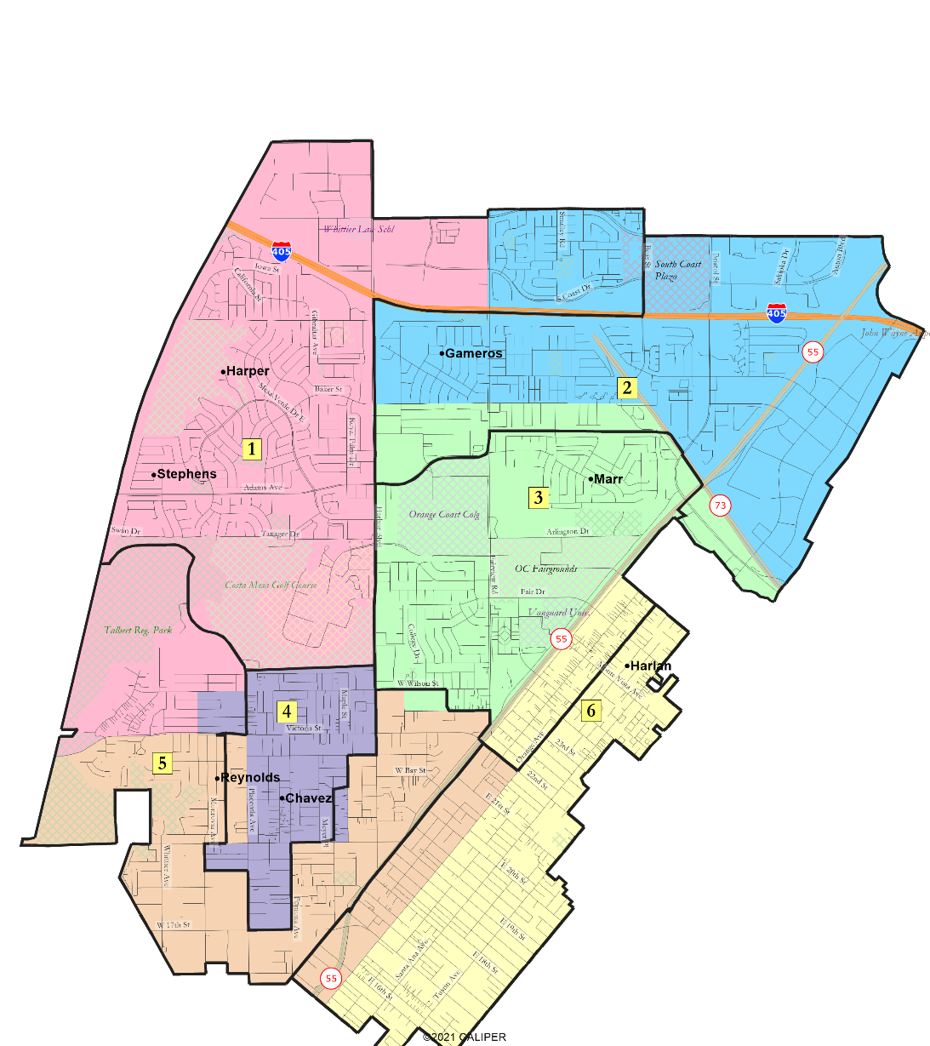
Map 109

Slide 13
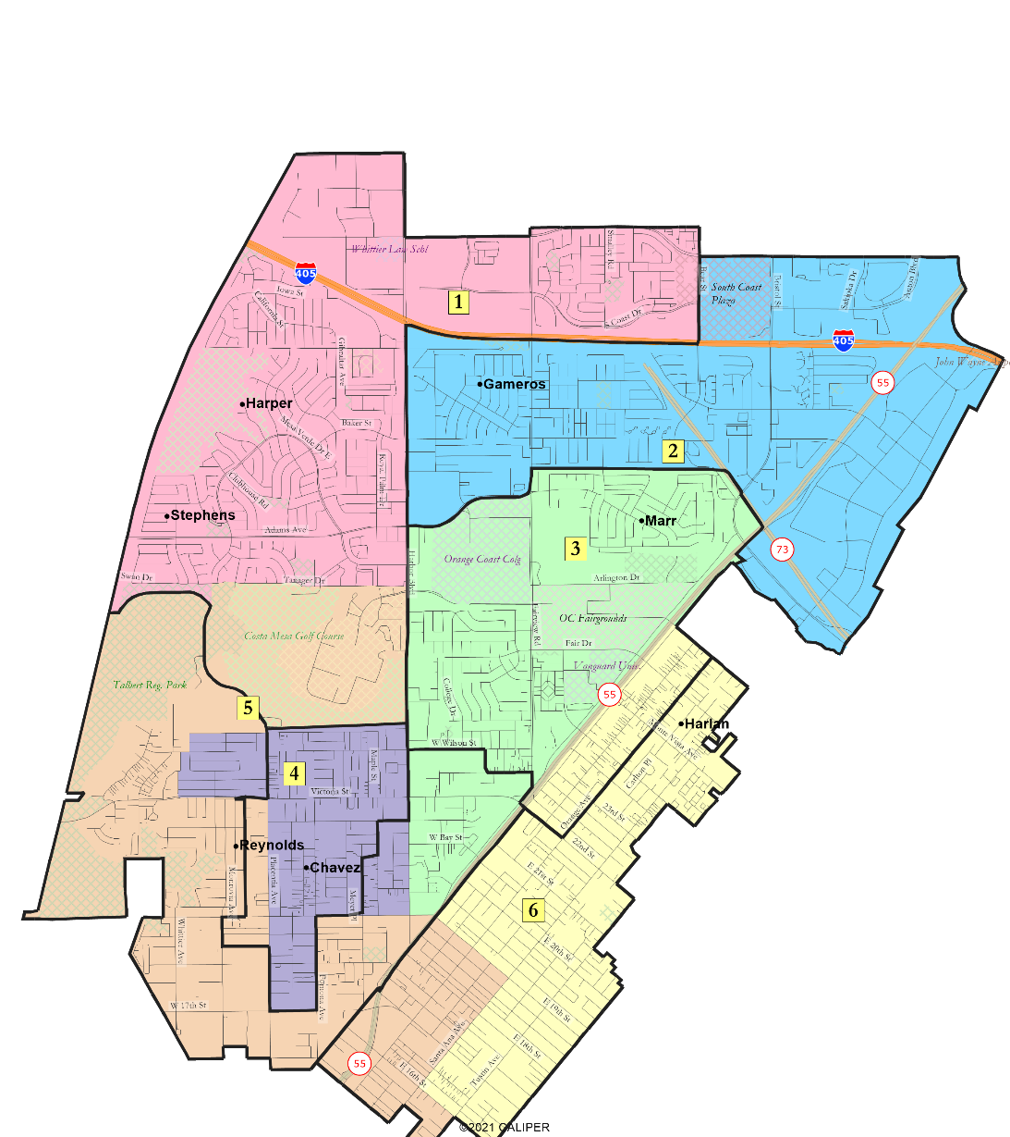
Map 110

Slide 14
Public Hearing & Discussion
What part of different draft maps do you like? What needs improving?
Are there any concepts you want to see or changes you want to a particular map?
1
2
3
5
4
6

Slide 15
Share Your Thoughts
Phone
714-754-5225 (City Clerk’s Office)
Email
Redistricting@costamesaca.gov
Website
http://redistrictcostamesa.org/

Slide 16
Public Mapping and Map Review Tools
Different tools for different purposes
Different tools for different levels of technical skill and interest
  Simple “review draft maps” tool
  Easy-to-use “Draw your neighborhood” tool
  Paper- and Excel-based simple “Draw a draft map” tools
  Powerful, data-rich “Draw a draft map” tool
Whether you use the powerful (but complicated) online mapping tool, Excel, the paper kit, or just draw on a napkin, we welcome your maps!

Slide 17
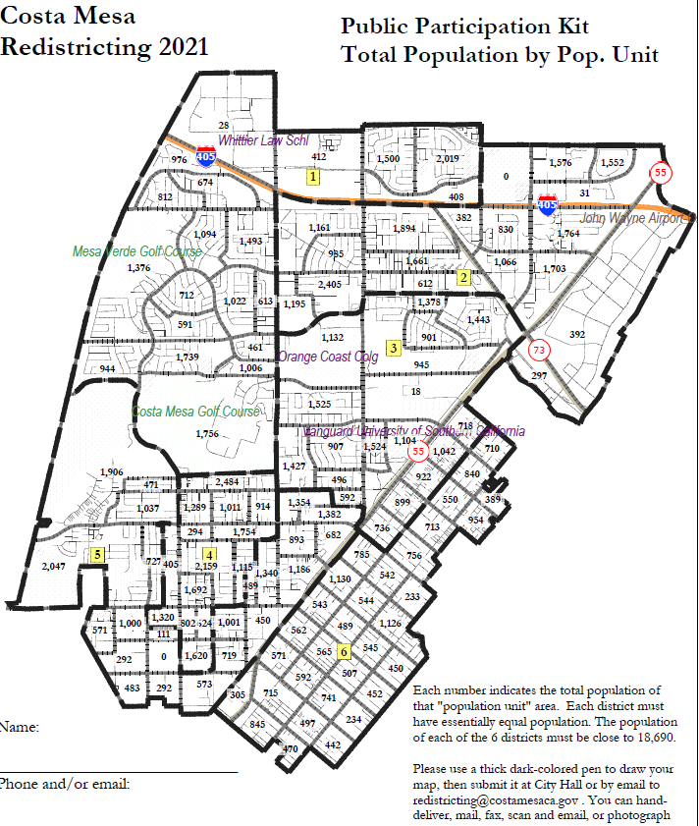
Simple Map Drawing Tool
Paper “Public Participation Kit”
For those without internet access or who prefer paper
Total Population Counts only – no demographic numbers

Slide 18
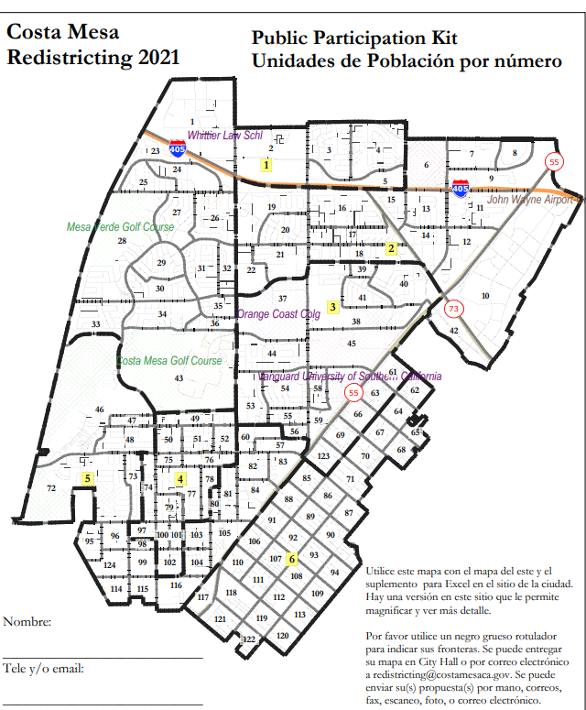
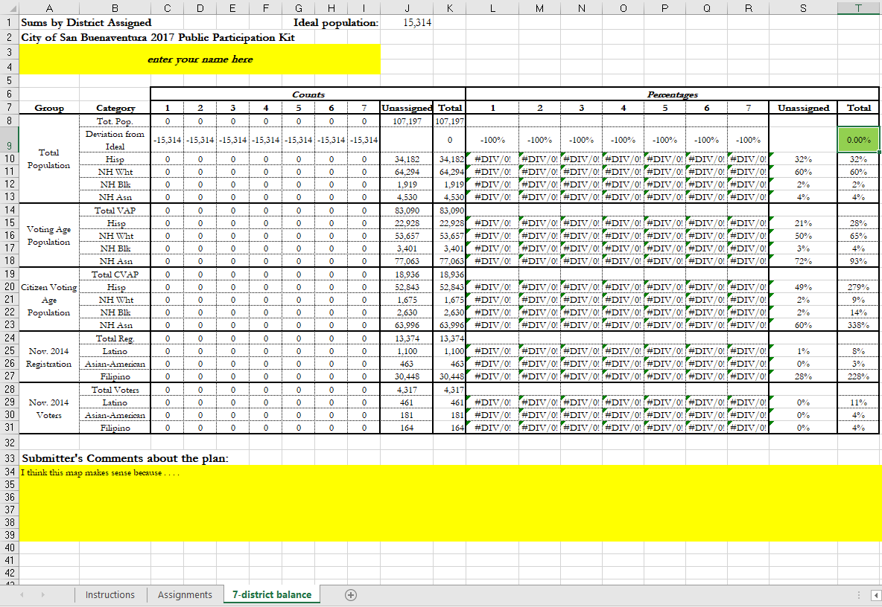
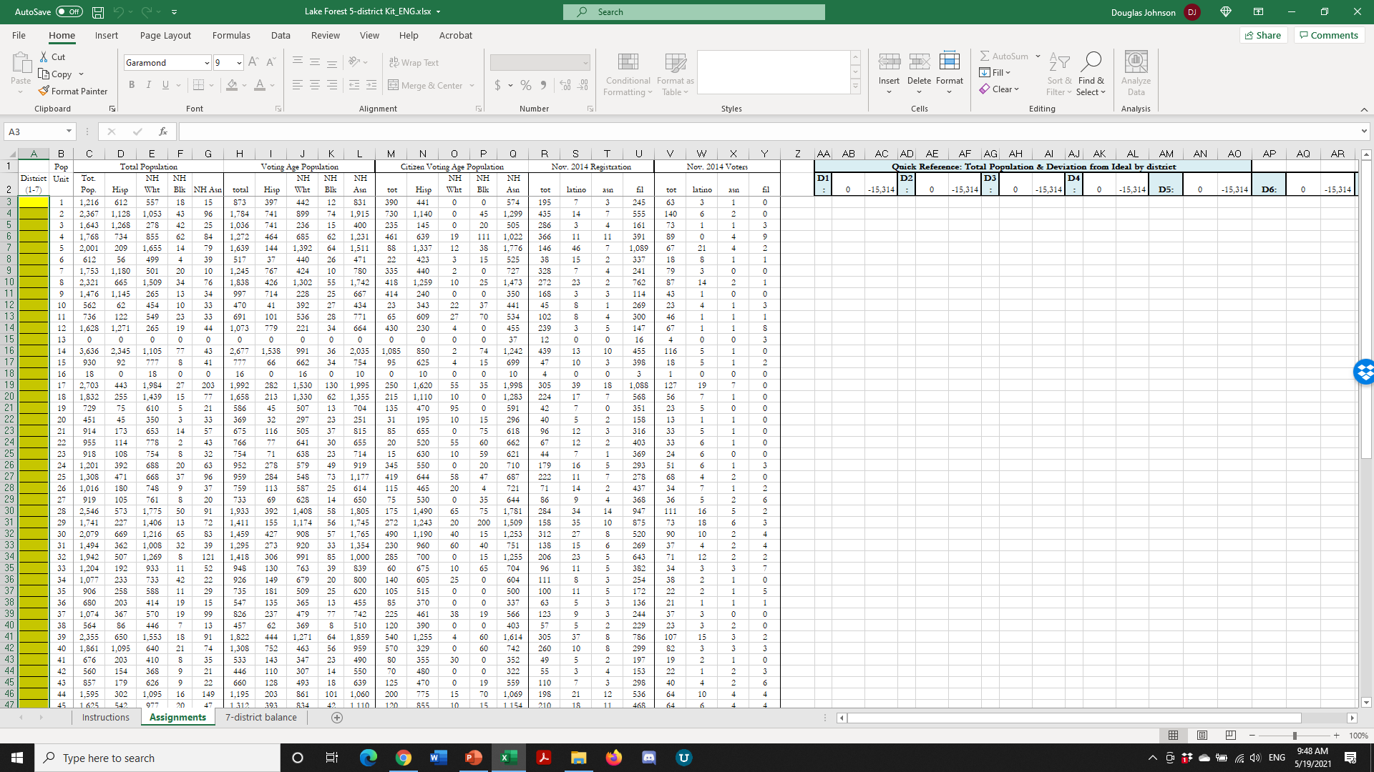
Simple Map Drawing Tool + Excel Supplement
“Public Participation Kit”
For those who know Excel and do not wish to use online tools
Adds CVAP data
Excel does the math

Slide 19
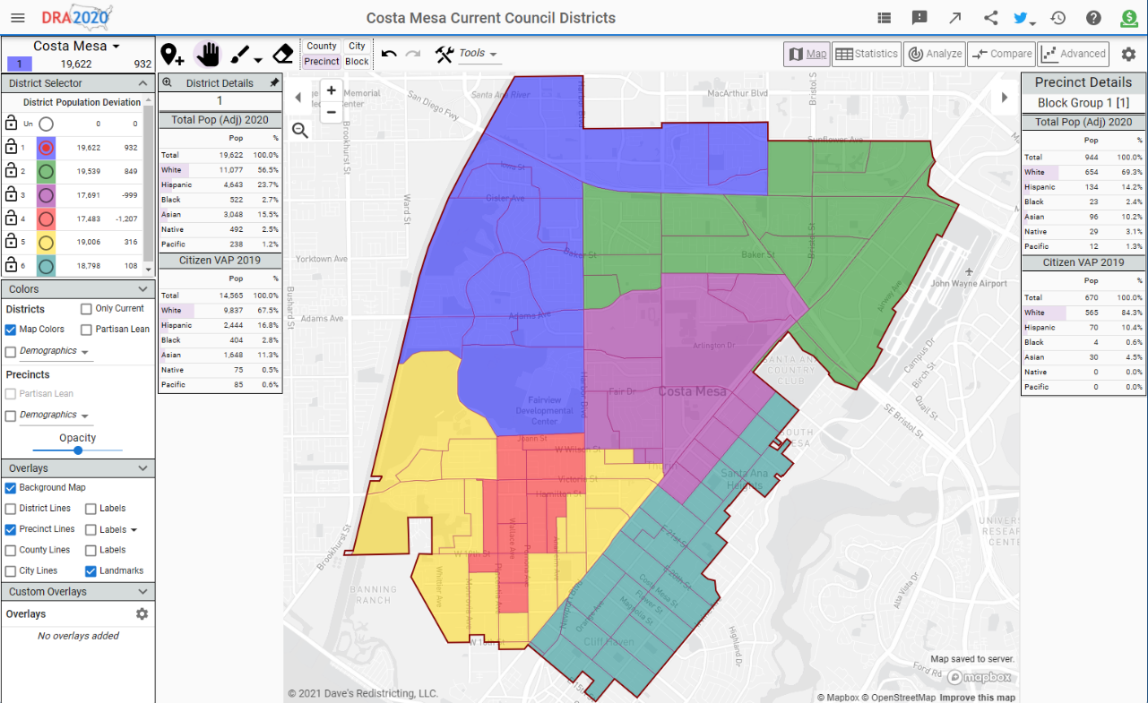
Dave’s Redistricting App (DRA)
“Draw Your Community of Interest” focus
Also includes simple district-mapping tool
Only available in English
Similar external options: Representable.org, DrawMyCACommunity.org

Slide 20
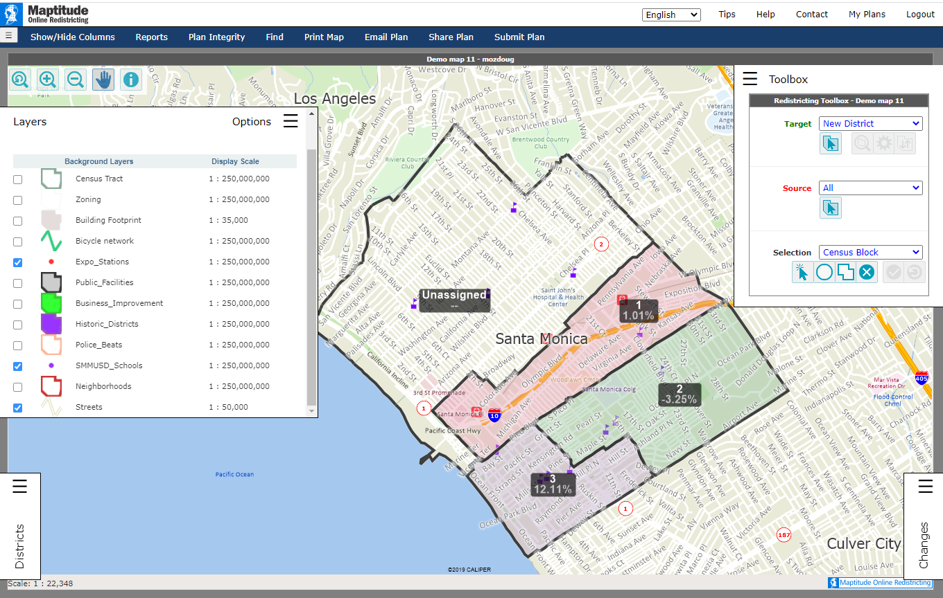
Caliper’s “Maptitude Online Redistricting”
Full Database, Powerful Online Mapping Tool
Powerful, common, data-rich online tool
Six language options: English, Spanish, Portuguese, Vietnamese, Mandarin and Korean
Quick Start Guide

